Slide 1
dimensionality Reduction

Slide 2
methods
Low Variance Filter,
High Correlation Filter
Backward Feature Elimination
Forward Feature Selection
Principle Component Analysis(PCA)
Projection Methods.

Slide 3

Dimensionality reduction Dimensionality reduction is essential in data processing to reduce the number of variables in a dataset, improving efficiency and performance without losing essential information. One of the techniques for dimensionality reduction is the Low Variance Filter:

Slide 4
Low Variance Filter
The Low Variance Filter is a simple technique that removes features (columns) from a dataset based on their variance.
The logic is that features with very low variance have minimal fluctuation and carry limited informational value.
Such features are often considered redundant or non-informative because they do not contribute significantly to distinguishing between classes or influencing predictions in a model.

Slide 5
How It Works:
Calculate Variance: For each feature in the dataset, calculate its variance.
Set a Threshold: Define a variance threshold below which features are considered low variance.
Filter Out Low Variance Features: Drop the features whose variance is below the set threshold, reducing the dimensionality of the dataset.

Slide 6
Example:
Consider a dataset with a column that has nearly the same value across all samples (e.g., 0.001, 0.002, 0.001). Such a column has low variance and likely does not add valuable information for predictive tasks, so it would be filtered out.

Slide 7

When to Use:
The Low Variance Filter is particularly useful when the dataset has a large number of features, and it's suspected that some do not vary enough to be informative. It’s a quick, rule-based approach and often serves as a preliminary step in dimensionality reduction before using more complex methods like Principal Component Analysis (PCA) or t-SNE.

Slide 8
import pandas as pd
from sklearn.feature_selection import VarianceThreshold
# Sample dataset
data = {
'A': [1, 1, 1, 1, 1],
'B': [0.1, 0.1, 0.1, 0.1, 0.1],
'C': [2, 2, 3, 4, 5],
'D': [10, 11, 10, 10, 11]
}
# Convert to DataFrame
df = pd.DataFrame(data)
# Set variance threshold (e.g., 0.1)
threshold = 0.1
selector = VarianceThreshold(threshold=threshold)
# Fit selector to data
selector.fit(df)
# Get the columns that pass the variance threshold
selected_features = df.columns[selector.get_support()]
# Create a new DataFrame with only the selected features
df_reduced = df[selected_features]
# Display the original and reduced data
print("Original Data:\n", df)
print("\nSelected Features with Variance above", threshold, ":\n", selected_features)
print("\nReduced Data:\n", df_reduced)
experiences, values, and emotions of those listening

Slide 9
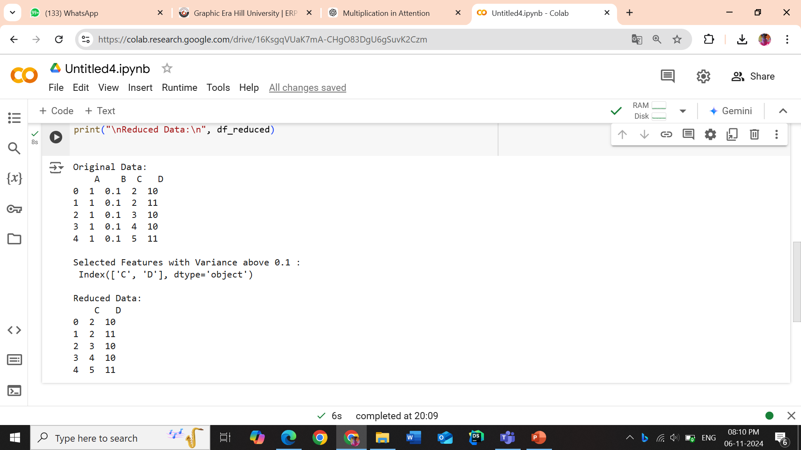
output

Slide 10
High Correlation Filter
A High Correlation Filter is a feature selection technique used in machine learning and data preprocessing to remove one of each pair of features that have high correlation. When two features are highly correlated, they carry redundant information, which can lead to overfitting and may slow down or negatively impact model performance.

Slide 11
Why Use a High Correlation Filter?
Reduce Redundancy: Highly correlated features contribute similar information to a model. Removing them reduces data dimensionality without losing much useful information.
Avoid Multicollinearity: In linear models, high correlation between features (multicollinearity) can destabilize the model’s coefficients and make them hard to interpret.
Improve Efficiency: Lower-dimensional datasets are computationally cheaper and reduce the risk of overfitting.

Slide 12
How It Works
The High Correlation Filter works as follows:
Compute Correlation Matrix: Calculate the correlation coefficients for all pairs of features.
Define a Threshold: Set a correlation threshold, usually between 0.8 and 0.95, depending on the tolerance for correlation.
Filter Features: For each pair of features exceeding this threshold, drop one of the features. The choice of which feature to drop can be arbitrary or based on domain knowledge.

Slide 13
Example
Suppose we have a dataset with features A, B, and C and we find:
A and B have a correlation of 0.92
A and C have a correlation of 0.3
B and C have a correlation of 0.25
With a threshold of 0.9, we can drop B since it is highly correlated with A, and keep A and C.

Slide 14
import pandas as pd
import numpy as np # Import numpy directly
# Example DataFrame with sample data
data = {
'A': [1, 2, 3, 4, 5],
'B': [2, 4, 6, 8, 10],
'C': [1, 2, 1, 2, 1],
'D': [10, 9, 4, 5, 3]
}
df = pd.DataFrame(data)
# Set the correlation threshold
threshold = 0.8
# Calculate the correlation matrix
corr_matrix = df.corr().abs()
# Select upper triangle of correlation matrix
upper_tri = corr_matrix.where(np.triu(np.ones(corr_matrix.shape), k=1).astype(bool))
# Find columns with correlation above threshold
to_drop = [column for column in upper_tri.columns if any(upper_tri[column] > threshold)]
# Drop the features with high correlation
df_filtered = df.drop(columns=to_drop)
print("Original DataFrame:")
print(df)
print("\nFiltered DataFrame:")
print(df_filtered)

Slide 15
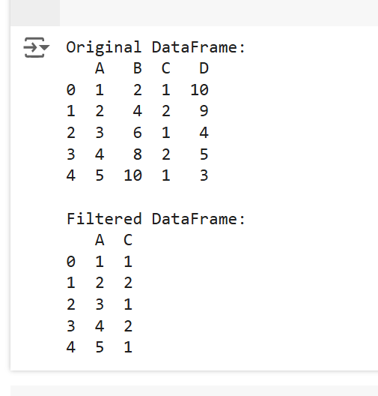
output

Slide 16
1. Backward Feature Elimination
Backward Feature Elimination and Forward Feature Selection are two commonly used feature selection techniques in machine learning that help to reduce the dimensionality of data by identifying the most relevant features. Here’s an overview and some example code for both:
1. Backward Feature Elimination
Backward Feature Elimination (or "Backward Elimination") begins with all features and iteratively removes the least significant feature at each step. This is done until the model meets a specified performance criterion or reaches a predefined number of features.
Backward Feature Elimination removes features that contribute least to model performance.

Slide 17
2. Forward Feature Selection
Forward Feature Selection
Forward Feature Selection (or "Forward Selection") starts with an empty set and iteratively adds the most significant feature at each step. This continues until the model reaches a desired performance level or a specified number of features.
Forward Feature Selection builds up from an empty set by adding features that best improve performance.

Slide 18
Principal Component Analysis (PCA)
Principal Component Analysis (PCA) is a dimensionality reduction technique that transforms the data into a new coordinate system, reducing the number of features while preserving the variance. It helps in:
Reducing dimensionality for visualization or computational efficiency.
Removing multicollinearity (redundant features).
Extracting important features (principal components) that capture the most variance in the data.

Slide 19
terminology
Variance: PCA finds the directions (principal components) that maximize the variance in the data.
Principal Components: New axes that are linear combinations of the original features, ordered by the amount of variance they explain.
Eigenvalues and Eigenvectors: PCA relies on these to determine the principal components.

Slide 20
How PCA Works
Standardize the data (zero mean, unit variance).
Compute the covariance matrix.
Calculate eigenvalues and eigenvectors of the covariance matrix.
Sort eigenvectors based on eigenvalues (in descending order).
Project the data onto the principal components.

Slide 21
Projection methods
Projection methods for dimensionality reduction are techniques that transform high-dimensional data into a lower-dimensional space while preserving as much information (variance or structure) as possible. These methods are often used to simplify data, reduce computational complexity, and address multicollinearity.

Slide 22
most popular projection methods
1. Principal Component Analysis (PCA)
2. Linear Discriminant Analysis (LDA)
3. t-Distributed Stochastic Neighbor Embedding (t-SNE)
4. Multidimensional Scaling (MDS)
5. Independent Component Analysis (ICA)
6. Kernel PCA (KPCA)

Slide 23
Summary table
Method | Type | Preserves | Key Use Case
PCA | Linear | Variance | General dimensionality reduction
LDA | Supervised | Class separability | Classification tasks
t-SNE | Non-linear | Local structure | High-dimensional visualization
MDS | Non-linear | Pairwise distances | Similarity visualization
ICA | Linear | Statistical independence | Signal separation
KPCA | Non-linear | Variance (in transformed space) | Non-linear data structures

